Slide 1
Payment Processing System
Team Members:
Vinay Patel Raghav Lathi Priyanshu Bariyar
Enterprise grade payment infrastructure
Prepared by: Team AutoWired
Date: 7th August 2026

Slide 2
Table of Content
Covers
01
Table of contents
02
Problem Statement
03
Proposed Solution
04
Features
05
Architecture
06
Tech Stack
07
Demo
08
Business Impact
09

Slide 3
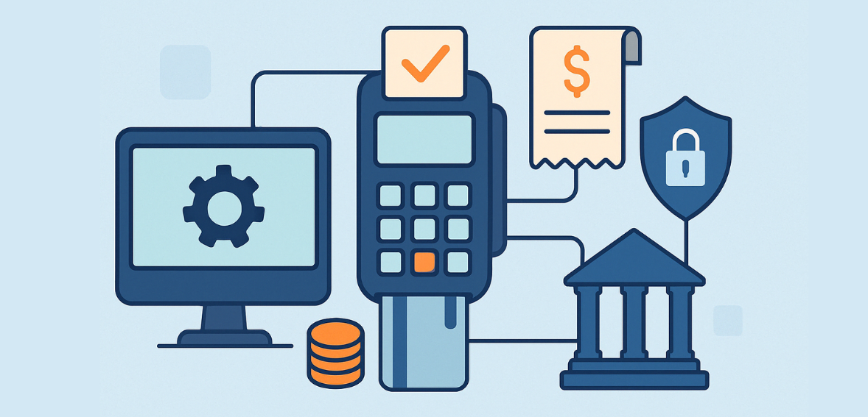
Problem Statement
Manual/legacy payment flows lack lifecycle visibility
No unified audit trail across payment stages
Fraudulent transactions often go undetected in real time
Rigid fee structures can't adapt to business needs

Slide 4
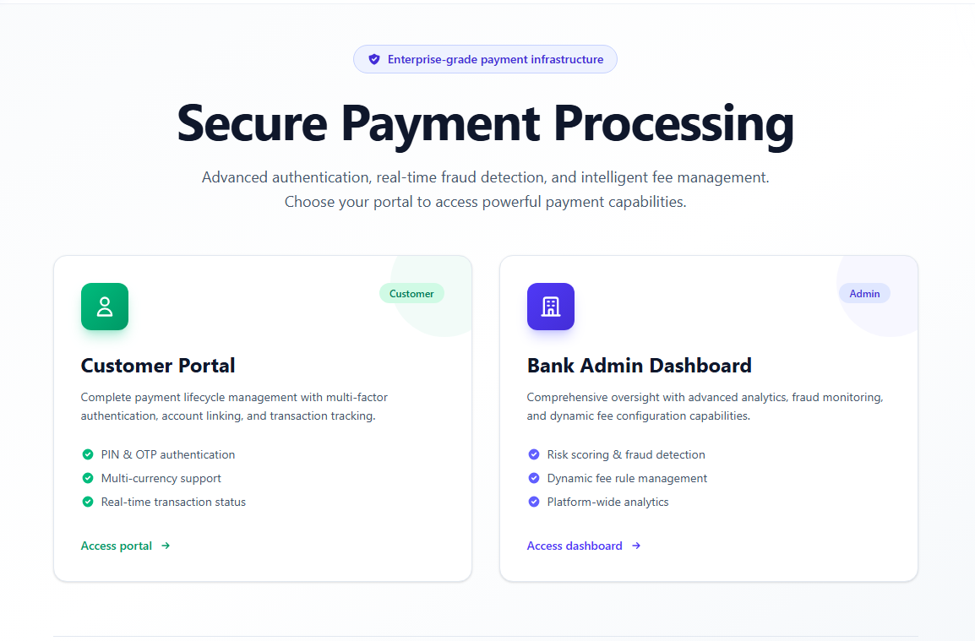
Proposed Solution
End-to-end payment processing platform with full lifecycle tracking
Two dedicated portals: Customer & Bank Admin
Automated validation, fraud scoring, and fee calculation
Secure PIN/OTP authentication before payment execution
Real-time dashboards for operational visibility

Slide 5
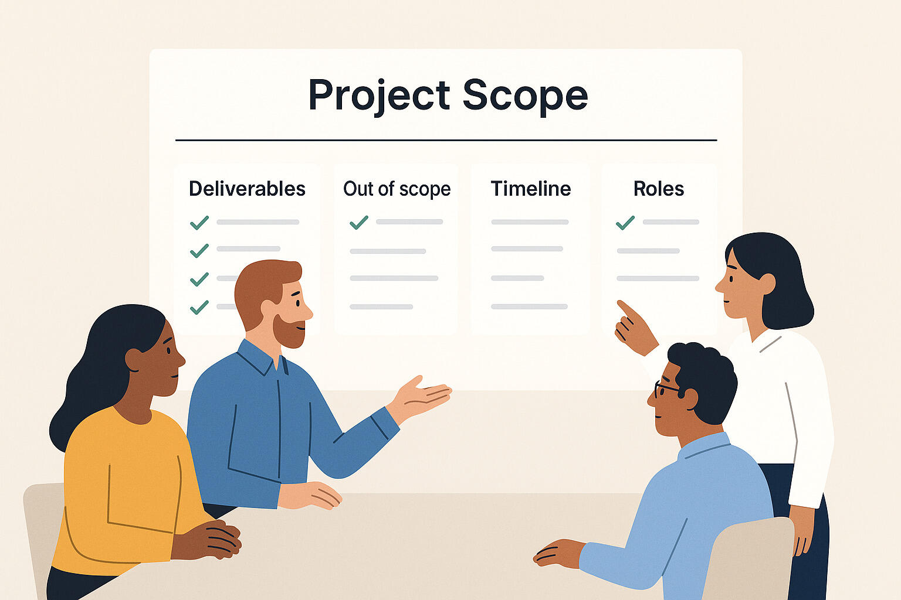
Scope of Project
In Scope: Full payment lifecycle, dual portals (Customer + Bank- Admin), fraud scoring, dynamic fees, PIN/OTP auth
Out of Scope: Live payment gateway/network integration (simulated internally)
Target Users: Bank customers & bank operations teams
Current State: Functional prototype/training project, not production-hardened

Slide 6
Features
Multi-Method Payments (UPI / NetBanking / Credit Card)
PIN & OTP Authentication
Real-Time Fraud Risk Scoring
Dynamic Fee Rule Engine
Full Audit Trail & Status History
Bank Admin Dashboard & Fraud Review

Slide 7
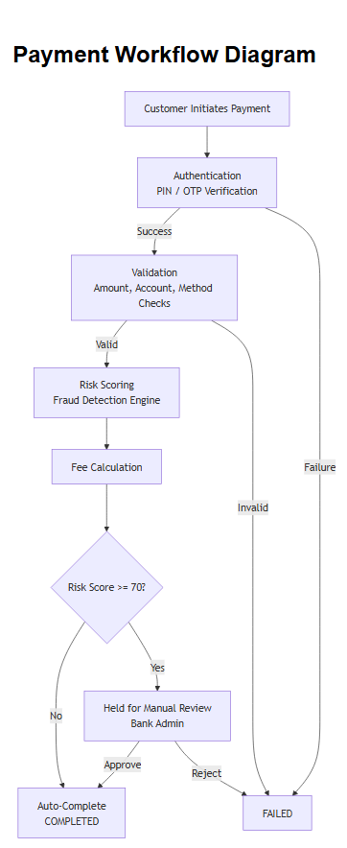
Architecture
Workflow
Customer initiates payment
Authentication (PIN/OTP verification)
Validation (amount, account, method checks)
Risk Scoring (fraud detection engine)
Fee Calculation & Settlement (auto or manual review)

Slide 8
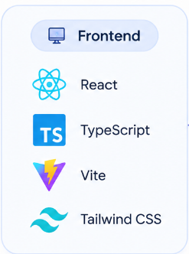
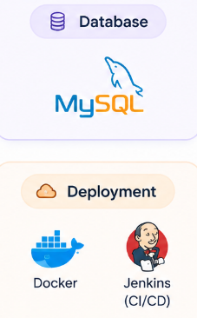

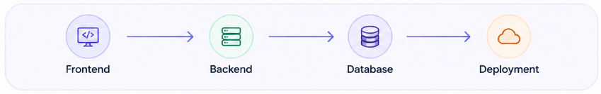
Tech Stack

Slide 9
Demo
Demo Flow
Customer Portal: Link account → Make Payment (PIN/OTP)
View Payment Status & History
Bank Admin: Overview Dashboard
Fraud Alerts: Review & Approve/Reject
Fee Rules Configuration

Slide 10
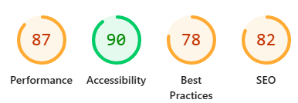
Non-Functional Requirements (NFR)
Accessibility: Semantic HTML, ARIA labels, keyboard-navigable modals
Performance: Optimized polling intervals, memoized rendering, async API calls
SEO: Clean routing, semantic markup, meta tags for discoverability
Reliability: Idempotency handling, error boundaries, full audit trail
Scalability: Layered architecture ready for horizontal scaling
LIGHTHOUSE REPORT OF WEBSITE

Slide 11
Future Enhancements
Spring Security: JWT/OAuth2-based authentication & role-based access control
REST API Maturity: API versioning, HATEOAS, full OpenAPI/Swagger documentation
Internationalization (i18n): Multi-language UI support for global customers
Advanced Security: Data encryption at rest, rate limiting, enhanced audit logging
Real Gateway Integration: Connect to live payment networks (Visa/SWIFT/UPI rails)

Slide 12

Business Impact
Faster, transparent payment lifecycle tracking
Reduced fraud losses via automated risk scoring
Configurable fees without code changes
Scalable to new payment methods & currencies
Foundation for real payment gateway integration

Slide 13


